Slide 1

History of computers

Slide 2
The computer itself is a machine that performs tasks and solves problems by storing and manipulating information.
Information stored in computers is digital (it consists of discrete digits).

Slide 3
History of computers
The history of computers begins with the people's need to calculate and keep records. From ancient times, people have working to invent a computing device to assist them in calculating and processing data.

Slide 4
All the data processing equipment can be categorized under three types:-
1- Mechanical devices: Which are hand-operated such as the "ABACUS" and the "Slide rule".
2- Electro-mechanical devices: Which are powered by an electric motor and use switches and relays, e.g. "Card reader" and "Card stored".
3- Electronic devices: Which have such components as "Transistors, Circuits, Chips", e.g. "Modern Computer".

Slide 5
We outline historical evolution of the computer in three stages:
1- The dark (earliest) ages:(3000 B.C – 1890 A.D)
2- The middle ages: (1890 – 1944)
3- The modern ages: (1944 till now)
B.C(Before Christ)
A.D(After Death or Anno Domini)

Slide 6
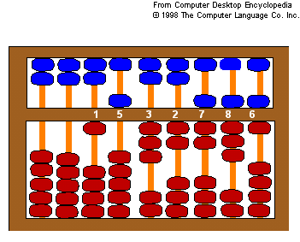
1- The Dark Ages: (3000 B.C – 1890 A.D)
This stage refers to the period in which only manual "Mechanical devices" were used:
* ABACUS
Date of development:
3000 B.C (5000 years ago)
Place: China
Function: Arithmetic calculation

Slide 7
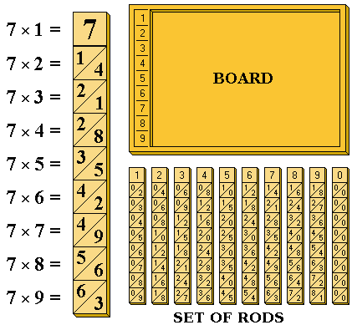
* Napier's Bones
Date: 1617
Place: Scotland
Inventor: John Napier
Function: Multiplication and Division

Slide 8
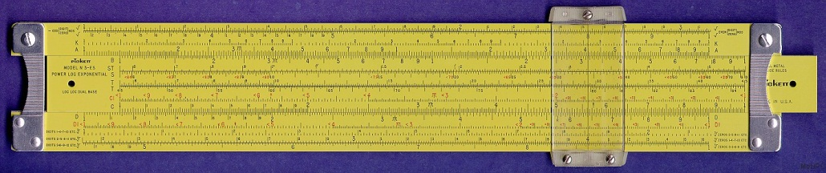
* Slide Rule
Date: 1632
Place: England
Inventor: William Oughtred
Components: Two movable rules
Function: Multiplication and Division

Slide 9
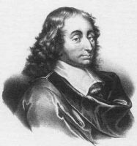
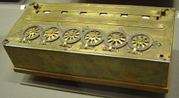
* Pascal Arithmetic Machine
Date: 1642
Place: France
Inventor: Blasé Pascal
Function: All the arithmetic
operations but it required
considerable manual effort for
Multiplication and Division
Blasé Pascal

Slide 10
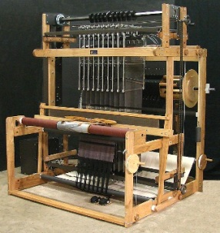
* Jacquard Loom
Date: 1801
Place: France
Inventor: Joseph Marie Jacquard
Components: Loom, threads and
control cards (punched cards)

Slide 11
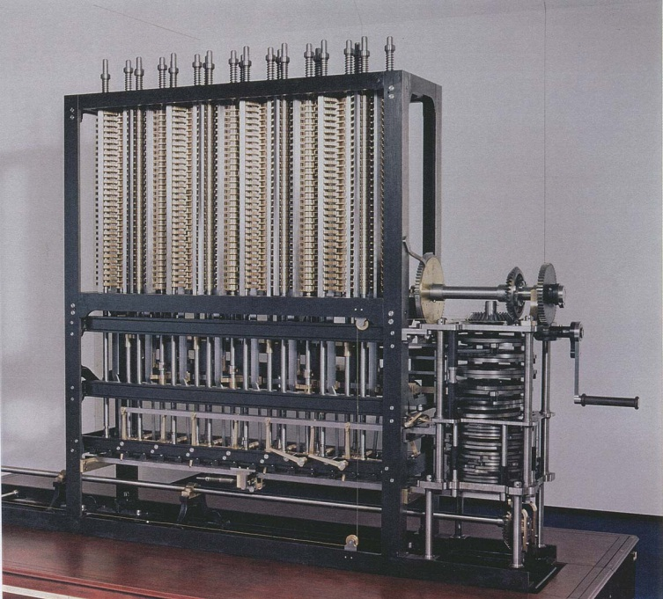
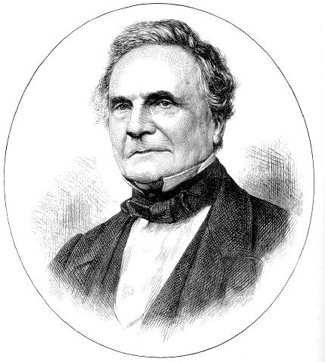
* Babbage's Analytical Engine
Date: 1833
Place: England/ Cambridge University
Inventor: Charles Babbage/Professor of mathematics
Charles Babbage

Slide 12
Components: The organization of the engine was remarkably similar to that of the modern digital computer.
Major innovation:
Arithmetic unit
Punched-card input
Printing unit and control system
Storage unit (1000 numbers of 50 decimal digits each)

Slide 13
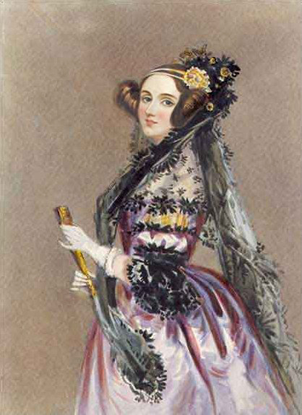
* Ada Lovelace
Birth: 10/Dec./1815 in London, England
Death: 27/Nov./1852 in London, England
Nationality: British

Slide 14
Noun: Computer program in punched cards
Invention: Computer programming in 1843
Inventor: Augusta Ada Lovelace
Definition: In computer science, a sequence of instructions that a computer can interpret and execute; "the program required several hundred lines of code"

Slide 15
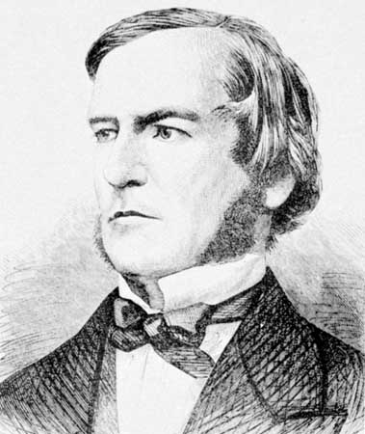
* Boolean Logic
In 1854, George BOOLE, a British mathematician performed a mathematical system named "Boolean Logic", that is the mathematics of variables with values that can be only "True" or "False".

Slide 16
2- The middle ages: (1890 – 1944)
The major feature of this stage was the use of "Electro-Mechanical Device" to process data recorded on punched cards.
** Punched-card Tabulating Machine
Date: 1890
Place: USA Bureau Census
Inventor: Dr. Herman Hollerith

Slide 17
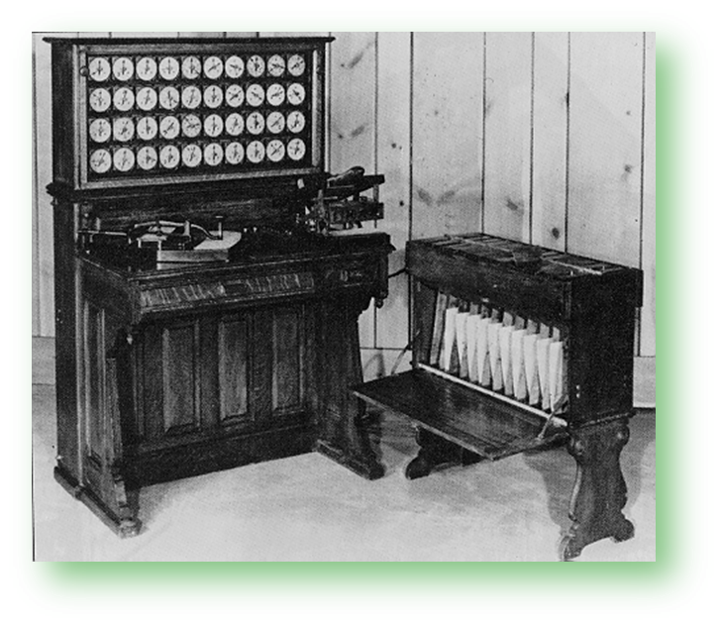
Major innovation: a punched device for recording information by punching holes on cards.
Punched-card Tabulating Machine

Slide 18
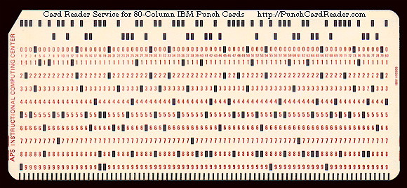
** The Simultaneous Punching Machine
Date: 1910
Place: USA Bureau Census
Inventor: James Power
Major innovation:
An earlier card-punched
equipment to cheek and
correct data before it was actually punched onto cards.
Punched card

Slide 19
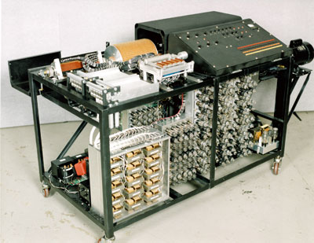
** ABC (Atanasoff Berry Computer)
Date: 1938
Place: Iowa State College
Inventor: Dr. John Vincent Atanasoff and Clifford Berry
Major innovation: a special purpose computer

Slide 20
3- The Modern Ages: (1944 till now)
The major feature of this stage was the use of "Computers" to process data and storage.
*** MARK 1
Date: 1944
Type: The first electro-mechanical computer "automatically performing of arithmetical and logical operations"
Inventor: IBM Company/ Howard G. Aiken, Professor of Math's at Harvard University
Size: 50 foot long, 8 foot high

Slide 21
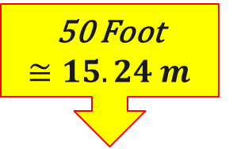
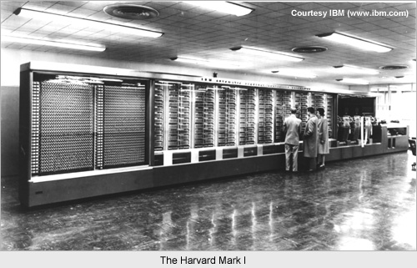
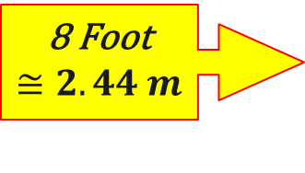
Speed:
3 additions per second
1 multiplication in 5 seconds
1 division in 12 seconds
50 Foot
8 Foot

Slide 22
*** ENIAC
Date: 1946
Type: The first electronics digital computer "automatically performing of arithmetical and logical operations"
Inventor: Dr. John Mauchly in USA
Weight: 30 Ton

Slide 23
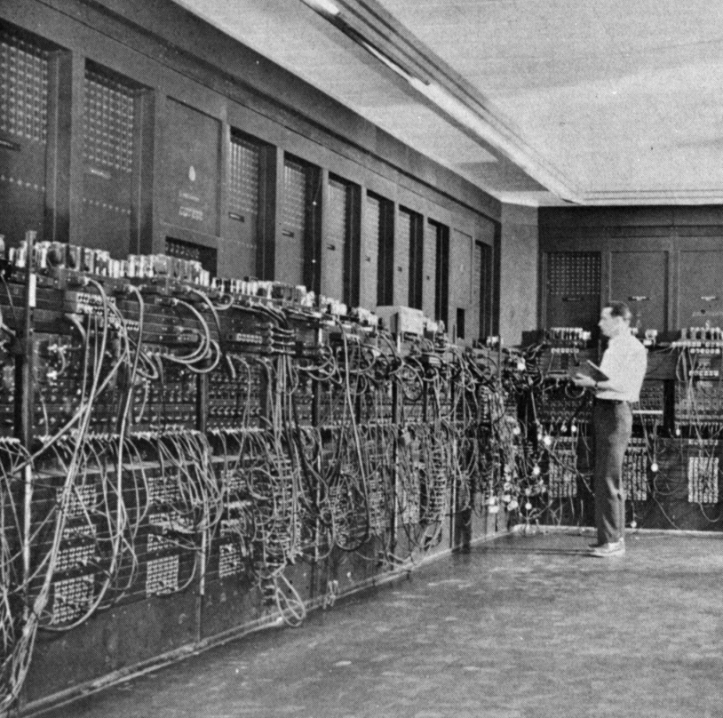
Speed:
5000 additions per second
350 multiplications per second
40 divisions per second
ENIAC

Slide 24
Generations of Computer
First Generation of Computer (1946-1959)
Main Features
Major Innovation: Vacuum Tubes
Main Memory: Punched Cards
Input Output Devices: Punched cards and papers
Languages: Low level machine language
Operating System: No operating system, human operators to set switches
Size: Main frame for example ENIAC, EDVAC, UNIVAC

Slide 25
Advantages of First Generation
1. Vacuum tubes were used as electronic component.
2. Electronic digital computers were developed for the first time.
3. These computers were the fastest calculating devices of their time.
4. Computations were performed in millisecond.

Slide 26
Disadvantages of First Generation
1. Too large in size.
2. They were unreliable.
3. Induce a large amount of heat due to the vacuum tubes.
4. Not portable.
5. Limited commercial use.

Slide 27
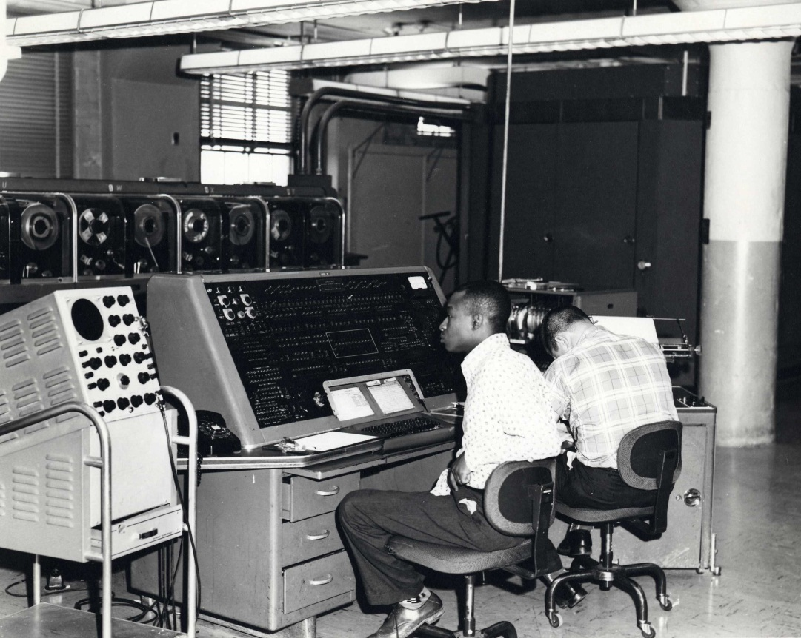
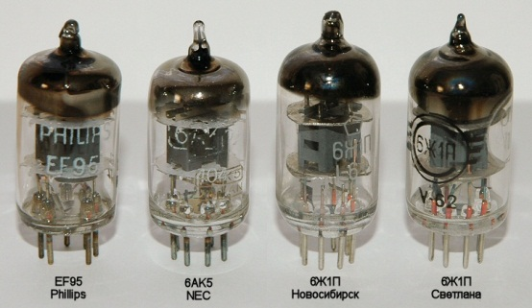
Vacuum Tube
UNIVAC

Slide 28
Second Generation of Computers (1959-1964)
Main Features
Major Innovation: Transistors as main component.
Main Memory: RAM and ROM.
External Storage: Magnetic tapes and Magnetic Disk.
Input Output Devices: Magnetic tapes and Magnetic Disk.
Languages: Assembly language, some high level languages for Example BASIC, COBOL, FORTRAN.
Operating System: Human handles punched card.
Size: Mainframe for example IBM-1400, NCR-300, IBM-1600, UNIVAC-III, etc…

Slide 29
Advantages of Second Generation
1. Smaller in size as compares to 1st generation
2. Much more reliable
3. Less heat generated
4. Computation was performing in micro second
5. Less hardware and maintenance problem
6. Could be used for commercial use

Slide 30
Disadvantages of Second Generation
1. Very costly for commercial use
2. It still required frequent maintenance
3. Frequent cooling also required

Slide 31
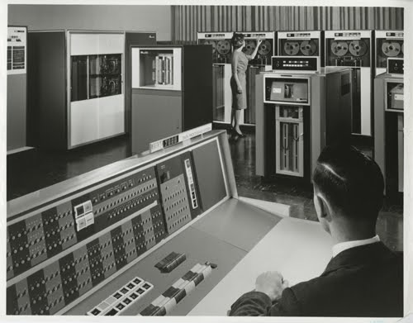
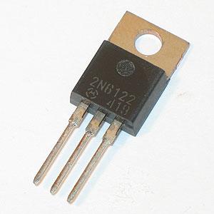
Transistor
IBM-1600

Slide 32
Third Generation of Computers (1965-1970)
Main Features
Major Innovation: Integrated circuit (ICs) as basic electronic component (SSIC and MSIC)
Main Memory: PROM and DRAM
External Storage: Improve disk (Floppy Disk)
Input and Output Devices: Keyboard for input, monitor for output
Languages: More high level languages
Operating System: Complete operating systems were introduced
Size: Mainframe and Mini Computer, for example: IBM SYSTEM /360, ICH-360, HONEY WELL-316, etc…

Slide 33
Advantages of Third Generation
1. Smaller in size as compared to second generation
2. More reliable
3. Portable
4. Less electricity consumption
5. Heat generation was rare
6. General purpose computer

Slide 34
Disadvantages of Third Generation
1. Air conditioning was required in many cases due to ICs
2. Very advance technology was required to make the ICs

Slide 35
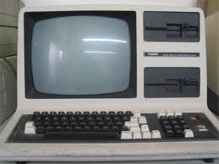
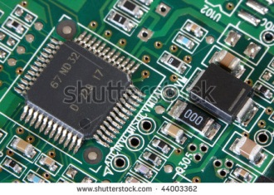
Integrated Circuit (ICs)
Computer
in 3rd Generation

Slide 36

Fourth Generation of Computers (1971-1981)
Main Features
Major Innovation: LSIC and VLSIC (Micro Processor)
Main Memory: EPROM and SRAM.
External Storage: Floppy Disk and Hard Disk.
Input and Output Devices: Monitor for output.
Languages: Languages and application software.
Operating System: MS-DOS and PC-DOS
Size: Microcomputer e.g. IBM-PC, Apple Macintosh etc..

Slide 37
Advantages of Fourth Generation
1. Smaller in size and much reliable
2. No cooling system required in many cases
3. Much faster computation
4. Portable and cheap
5. The heat generated was negligible
6. Totally general purpose computer
Disadvantages of Fourth Generation
1. Very advanced technology was required to fabricate to the ICs

Slide 38
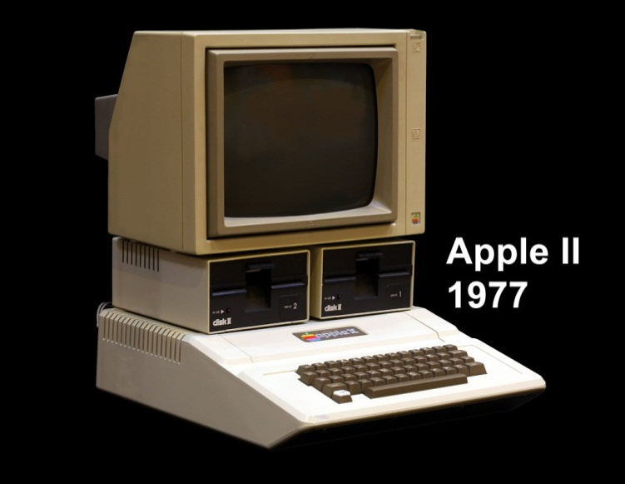
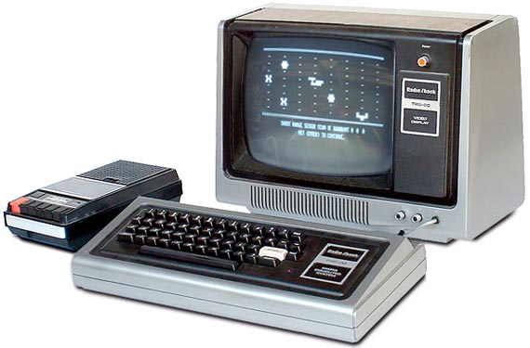
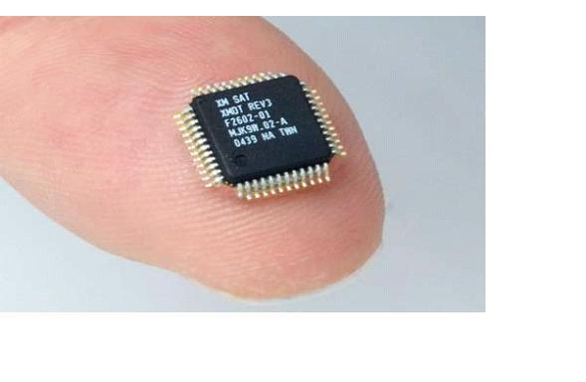
Computer
In 4th Generation
Apple II -1977
VLSI
Very large scale integrated circuit

Slide 39
Fifth Generation (1981-Onward)
Main Features
Major Innovations: ULSIC (Ultra large scale integrated circuit)
Main Memory: EEPROM, SIMM and DIMM.
External Storage: Modified magnetic and Optical disks.
Input/output Devices: Keyboard, Pointing Device, Scanner as input and Monitor as main output.
Languages: AI (Artificial Intelligence) Expert systems.
Operating System: GUI based e.g. Windows (95, 98, 2000, NT, XP, Vista, Seven and Eight)
Size: Very small in size example: Laptop, Note book, Digital Diary, Palmtop and Pocket PC.

Slide 40
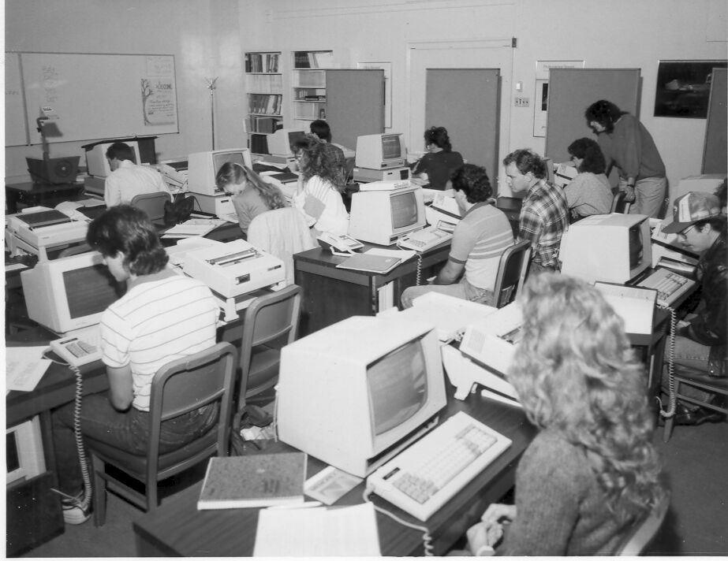
Advantages of 5th Generation
1. Very large storage capacity
2. Long bit processor builds
3. Artificial Intelligence Language developed
Computer Lab. In
1985

Slide 41
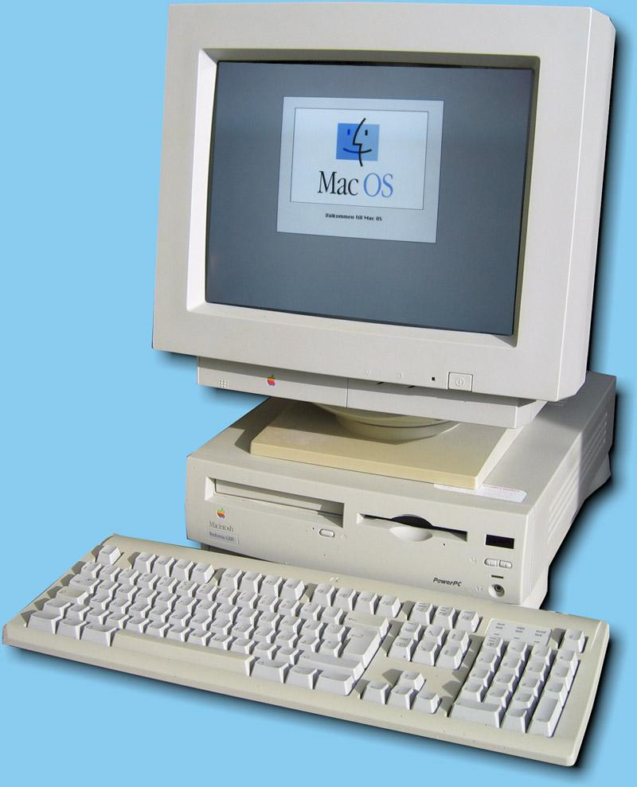
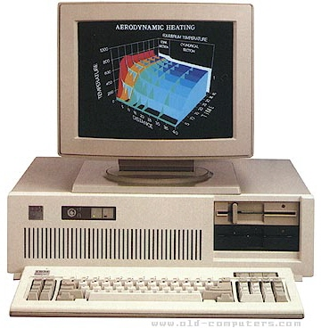
Computer
In 1990
Computer
In 1995

Slide 42
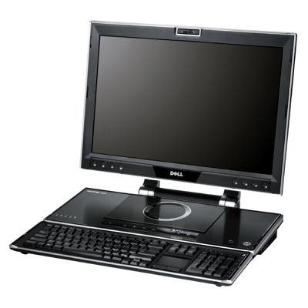
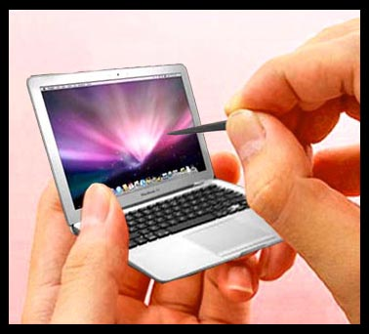
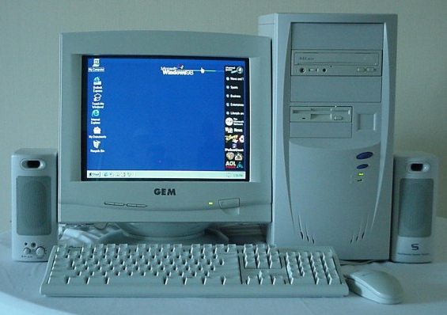
2005
2010
2012

